Slide 1
Services in Angular

Slide 2
Why Services
Components shouldn't fetch or save data directly from controllers
Services are a great way to share information among classes that don't know each other.
Steps to use service object from controller
a)generate the service → ng generate service <servicename>
b)Inject the service object in controller
c)Call the method based on events or some methods

Slide 3
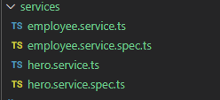
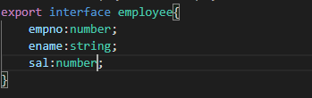

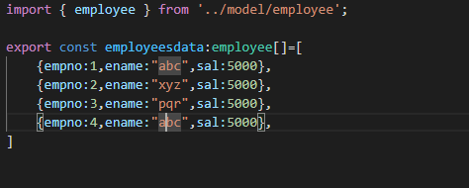
ng generate service
Move the generate service class code into some service folder
so that it will be clear for us with all service codes in single folder
→create all model classes in separate folder
→create some mock data for testing (this mock data will be giving from service to controller

Slide 4
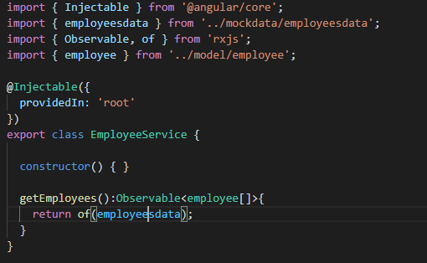
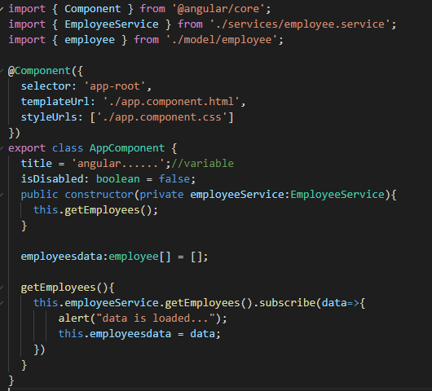
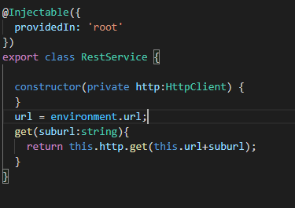
→Add following code in service class
Consume the data from Service class

Slide 5
Observables provide support for data sharing between publishers and subscribers in an angular application.
It is referred to as a better technique for event handling, asynchronous programming, and handling multiple values as compared to techniques like promises.
An observable can deliver multiple values of any type.
The API for receiving values is the same in any condition and the setup and the logic are both handled by the observable.
Rest thing is only about subscribing and unsubscribing the information required.

Slide 6
Hands-on
This hands is continue to above program
a)Create separate page which is having some textboxes for employee data
b) Once we click submit button the data should added to existing array employee data

